Slide 1
PROJECT
Voice to Sign language Converter and vice versa

Slide 2
ABSTRACT
Sign language is the language of the deaf and mute.
In India, there are approximately 3 million people suffering from some kind of hearing problem
Around 2.1 million people suffering from some kind of speech impairment.
The aim of this project is to help ease the burden of these group of people.
1

Slide 3
Project Idea
The Project idea our group is planning to implement for our minor project is a voice to sign language converter and vice versa.
The use of this project is to decrease the communication gap faced by the mute and deaf and the people by making a program that can take in speech and convert it into indian sign language and also to take in sign language and convert it to
2

Slide 4
APPLICATIONS OF THIS PROJECT
Increasing the ease of communication between differently abled people and people who do not understand sign language
Can be used as a tool to teach and learn sign language to a normal person as there are not many schools that teach this language
Aims to reduce discrimination against this group of differenly abled population.
3

Slide 5
Gaps Identified in Current System
a) Hearing and speech impaired persons rely on
sign language to communicate among their peers
but this is not convenient to communicate with
normal persons as the latter do not understand
sign language.
b) To comprehend the words spoken by a person, a
deaf candidate relies on lip reading, which is an
age-old but highly erratic and unreliable
technique.
4

Slide 6
c) There is a huge communication gap between hearing and speech impaired persons and normal persons which creates social divide and leads to dearth of equal opportunity for disabled people. d) The applications available on Google Play Store are not of any significant use to Indian disabled people as they are based in English, which only the literate are blessed to know and use American Standard Sign Language which is not followed in India.
5

Slide 7
e) There is no single application or solution that integrates all the facets of communication and enables a disabled person to have an almost normal conversation with a normal person.
6

Slide 8
My Approach
We have decided to divide the project into 3 phases:
1st Phase : Build Program for converting speech into ISL
2nd Phase : Build Program for converting ISL into
Text/Speech
3rd Phase : Build a User Interface That facilitates the
above to Programs
7

Slide 9
Phase 1
1. Audio input on a Personal Digital Assistant(PDA) using
python PyAudio module.
2. Conversion of audio to text using Google Speech API.
3. Dependency parser for analysing grammatical structure of
the sentence and establishing relationship between words.
4. ISL Generator: ISL of input sentence using ISL grammar
rules.
5. Generation of Sign language with signing Avatar or with
Images
8

Slide 10
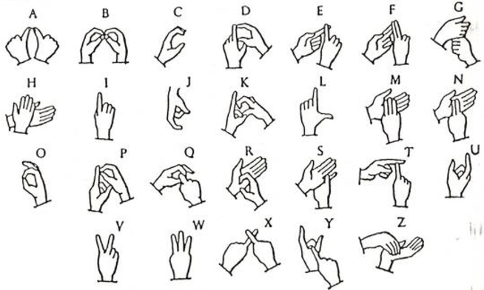
Phase 2
We would make the architectures of various self-developed and pre-trained deep neural networks, machine learning algorithms and their corresponding performances for the task of hand gesture to audio.
We will try to train the model to classify these hand gestures which correspond to a letter in the indian sign language and so forming words and sentences with these letters
9

Slide 11
Phase 3
Development of a User interface with the following technologies:
HTML
CSS
JavaScript
10

Slide 12
Thank You

